Slide 1
Introduction to Big Data
Day 5
Model Operations and Research Methods

Slide 2
Review Previous Lesson

Slide 3
Review Concepts from Day 4
During Day 4 you learned to:
Describe a range of different analytical modeling techniques
Statistical modeling
Data mining
Machine learning
Describe the Model Development Process CRISP-DM
Business Problem Framing
Data Collection and Evaluation
Data Preparation
Model Building
Model Evaluation
Model Deployment
Differentiate and recommend a suitable development process
Iterative
Waterfall
Identify the structure and role of Programs, Projects and Services in terms of model development
Analytic team composition and structure
Build and evaluate linear regression models using Python

Slide 4
Day 5 – New Topics Introduced
The following major topics are discussed this class.
Research concepts
Scientific method
Business questions
Critical thinking
Hypotheses
Sampling

Slide 5
Learning Objectives for Day 5

Slide 6
Day 5 - Learning Objectives
The course content provides some necessary context for operating and using analytical models that drive business impact.
The material will focus on using research driven approaches to formulate and explore business problems using data analytics.
The primary purpose of an analytical model is to generate information to a person that is curious and can generate meaningful and challenging questions.
The ability to generate these questions is based on thinking skills and research methods.
Benefits to the organization are generated if valuable insights are generated that can be applied to address business challenges based on the interaction between curious people, analytical models and a robust methodology.

Slide 7
Day 5 - Learning Objectives
During Day 5 you will learn to:
Identify and describe the approach and objectives of research
Describe two different types of research methods
Describe how research methods enable successful business impact of data analytics
Discover the business questions you are trying to answer with data analytics.
Determine if your data is appropriate to support your analytics initiative
Describe some data collection techniques and some related sampling concerns
Recognize how Operational Excellence initiatives drive analytics requirements
Check your data for some common issues in Python and interpret results from a regression model
Have a general understanding of what kinds of models for analysis are readily available in Sci-kit Learn Python

Slide 8
What is a Scientific Approach to Geography?
“Science is a personal and social human endeavor in which ideas and empirical evidence are logically applied to create and evaluate knowledge about reality.” Page 3
Loosely defined - A scientifically informed geography is one which uses a systematic empirical approach to produce its geographic knowledge.

Slide 9
Theoretical and Empirical symbiosis
Ultimately both empirical and theoretical approaches must be used for a complete and well rounded research approach
The balance of theoretical to empirical investigation does not have to be 50/50

Slide 10
Non-Scientific ways of knowing
It is important to realized that non-scientific ways of seeking knowledge are valuable in seeking issues of morality and human values - which systematic empirical approaches are illequipt for.
The humanities informally analyzing text and other symbolic artifacts of human thought, activity and culture to search for specific truths about places and times.

Slide 11
Common Metaphysical Beliefs Within Science
Realism - The universe is “real” outside of our heads.
Continuously connected and forward causality - Interconnectivity along linear time is needed for causality to be possible as we understand it.
Simplicity - The desire to use the “simplest” explanation that is adequate. However the relative degree of simplicity may be difficult to determine.
Skepticism - Scientists falsifying their way towards possible truth.
Quantitative thinking - Knowledge produced from systematic processes which can be recreated.

Slide 12
Metaphysical Beliefs: The nature of reality and the conceptual framework in which reality exists
Ontology - The alleged ultimate nature of reality
Epistemology - How scientists know about reality

Slide 13
Progressive Goals of Science
Description - The intellectual act of classification often carried out in a particularly systematic fashion.
Prediction - Using the findings of empirical data to predict unseen phenomena which are to come in the future or has already happened without leaving a clear record.
Explanation - Why previously described and predicted patterns exist
Control - Using the understanding of phenomena to alter and manipulate. Hopefully the modification is intended for good. Page 9

Slide 14
Goals of Science - Basic and Applied
Basic scientific research is concerned with the first three goals of science - description, prediction and explanation. It focuses on understanding reality for its own sake.
Applied scientific research is associated with the forth goal - control. Medical and educational research are applied sciences as the knowledge is actively employed.

Slide 15
History and Development of Geography
The broad and heterogeneous field of geography has changed and evolved throughout its own history.
Chorographic approach: Regional comprehension without global connectivity.
The Quantitative Revolution: We’re a real science
The Marxist/Feminist rebuttal: We’re into equality

Slide 16
The importance of research methodology and question development
“[A]ny empirical observations can potentially be explained not just by ideas about reality but also about the way they obtained or interpreted the observations.” - page 4

Slide 17
Research Concepts

Slide 18
Research Concepts Overview
Two major types of empirical research design
Qualitative research
Quantitative research
Qualitative Research
involves the understanding of human behavior and the reasons that govern such behavior
asks broad questions and collects unstructured data as words, images, video and audio
data is analyzed and summarized by themes.
aims to investigate a question without attempting to quantifiably measure variables or look to potential relationships between variables.
qualitative research is often used as a method of exploratory research as a basis for later quantitative research hypotheses.
Quantitative Research
empirical investigation of quantitative properties, phenomena and their relationships
asks narrow questions and collects numerical data to analyze it utilizing statistical methods.
the quantitative research designs are experimental, correlational, and survey based
statistics derived from quantitative research can be used to establish the existence of associative or causal relationships between variables.
quantitative data collection methods rely on random sampling and structured data collection instruments
- Source Wikipedia

Slide 19
Quantitative versus Qualitative
Quantitative Research Strategy
Investigation aims to assess a pre-stated theory (Deductive Reasoning)
Often involves hypothesis testing
Attempts to minimise the influence of the researcher on the outcome
Quantitative data infers statistics
Data collection therefore requires ‘closed’ responses
Qualitative Research Strategy
Investigation aims to create a novel theory (Inductive Reasoning)
Researcher becomes an inherent part of the study - ethnography
Qualitative data infers complex statements or opinions
Data collection therefore permits ‘open’ responses

Slide 20
Understanding “Understanding”
What do we mean by “understanding”?
Who does understanding benefit?
How do we understand something?
How does “understanding” differ from “explanation”.

Slide 21
Research Methods
The following two videos provide an overview of Qualitative and Quantitative research methods.
These videos provide an introduction to methods are useful when applied to a data analytics project.
Please review the two videos.
Qualitative Research
https://www.youtube.com/watch?v=IsAUNs-IoSQ
Quantitative Research
https://www.youtube.com/watch?v=cwU8as9ZNlA
Optional Video
This video provides a discussion that compares and contrasts the use of qualitative vs quantitative research methods
https://ed.ted.com/on/6116s1ZG

Slide 22
Understanding
Internal
It is about “me”
It deals with the subjective
Emotions
Feelings
A concern with quality rather than quantity
Putting back the human in human geography
Broadly humanistic traditions
The emergence of a strong cultural and social tradition within the discipline in the late 20th century

Slide 23
Theory and philosophy
Qualitative methods have been applied across a range of philosophical underpinnings
Limb and Dwyer (2001) emphasise their use in many different contexts
But, qualitative methods are underpinned by a particular conception of the role of research
Emphasis on quality of lived experiences
Many different kinds of interest in research
Habermas
Empirical analytic sciences and explanation
Historical hermeneutic sciences and understanding
Critical sciences and practice

Slide 24
Quantitative and Qualitative
Often described as being in opposition
Many decry the value of quantitative research
One of the ‘tensions’ between physical and human geography
Recent emphasis in human geography has been very much on qualitative methods
Geographers are not very good at mathematics!
A tendency for reduced emphasis on rigour
But this course wants to emphasise
The value of both quantitative and qualitative
Their appropriateness in different contexts

Slide 25
Qualitative data
Examples of qualitative data?
Interviewing
Focus Groups/discussions
Participant observation
Visual images
Texts
But how do we analyse these?
What indeed is qualitative analysis?

Slide 26
Qualitative methods: frameworks
Limb and Dwyer (2001) - four main types of methods:
In-depth, open-ended interviews
Group discussions
Participant observation
Texts
Maps
Literature
Archival material
Landscapes
Visual materials: pictures and films

Slide 27
Qualitative methods: frameworks
Limb and Dwyer (2001) - qualitative approaches share in common:
“Intersubjective understanding of knowledge”
“In-depth approach”
“Focus on positionality and power”
“Contextual and interpretative understanding”
But many texts focus on ‘methods’ to the exclusion of ‘analysis’
“analysis” not in Limb and Dwyer’s (2001) index!
Focus in this course is on how we analyse the data resulting from qualitative methods
Analysis integral to the methodology

Slide 28
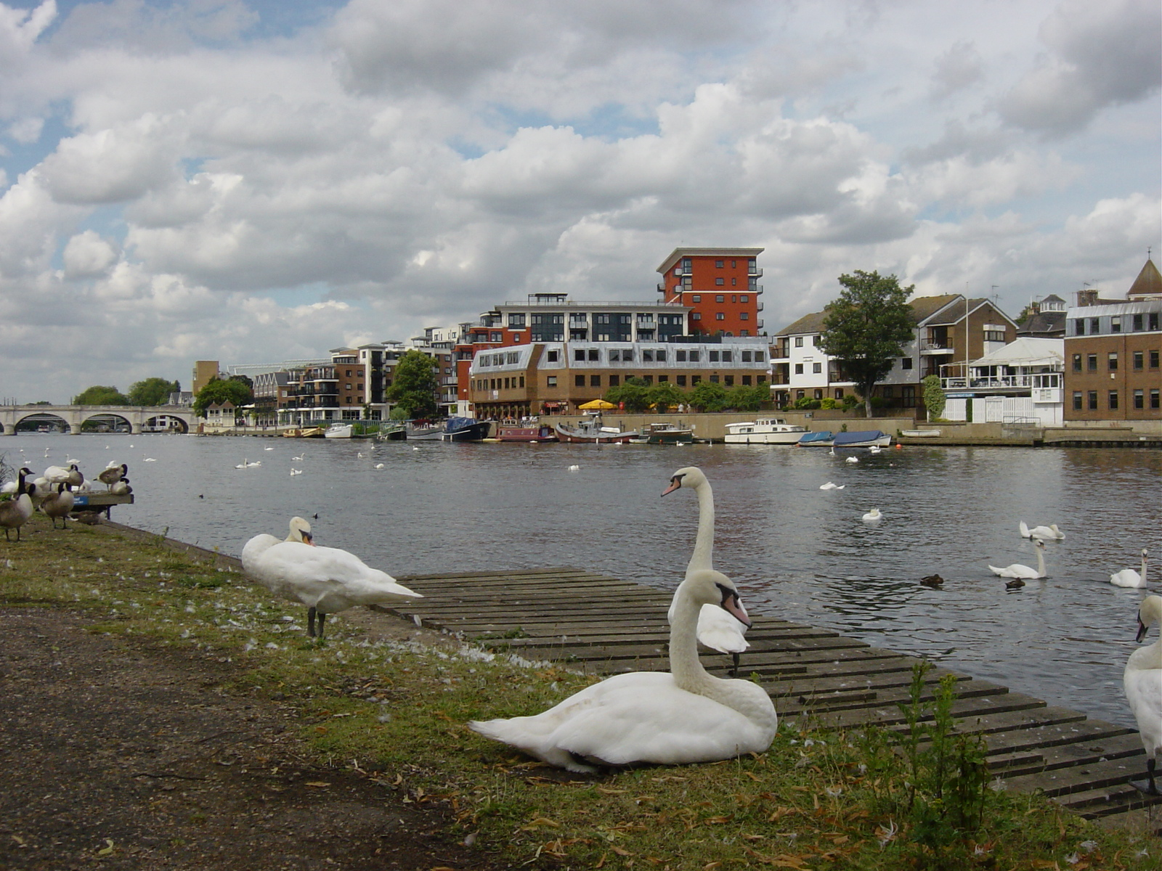
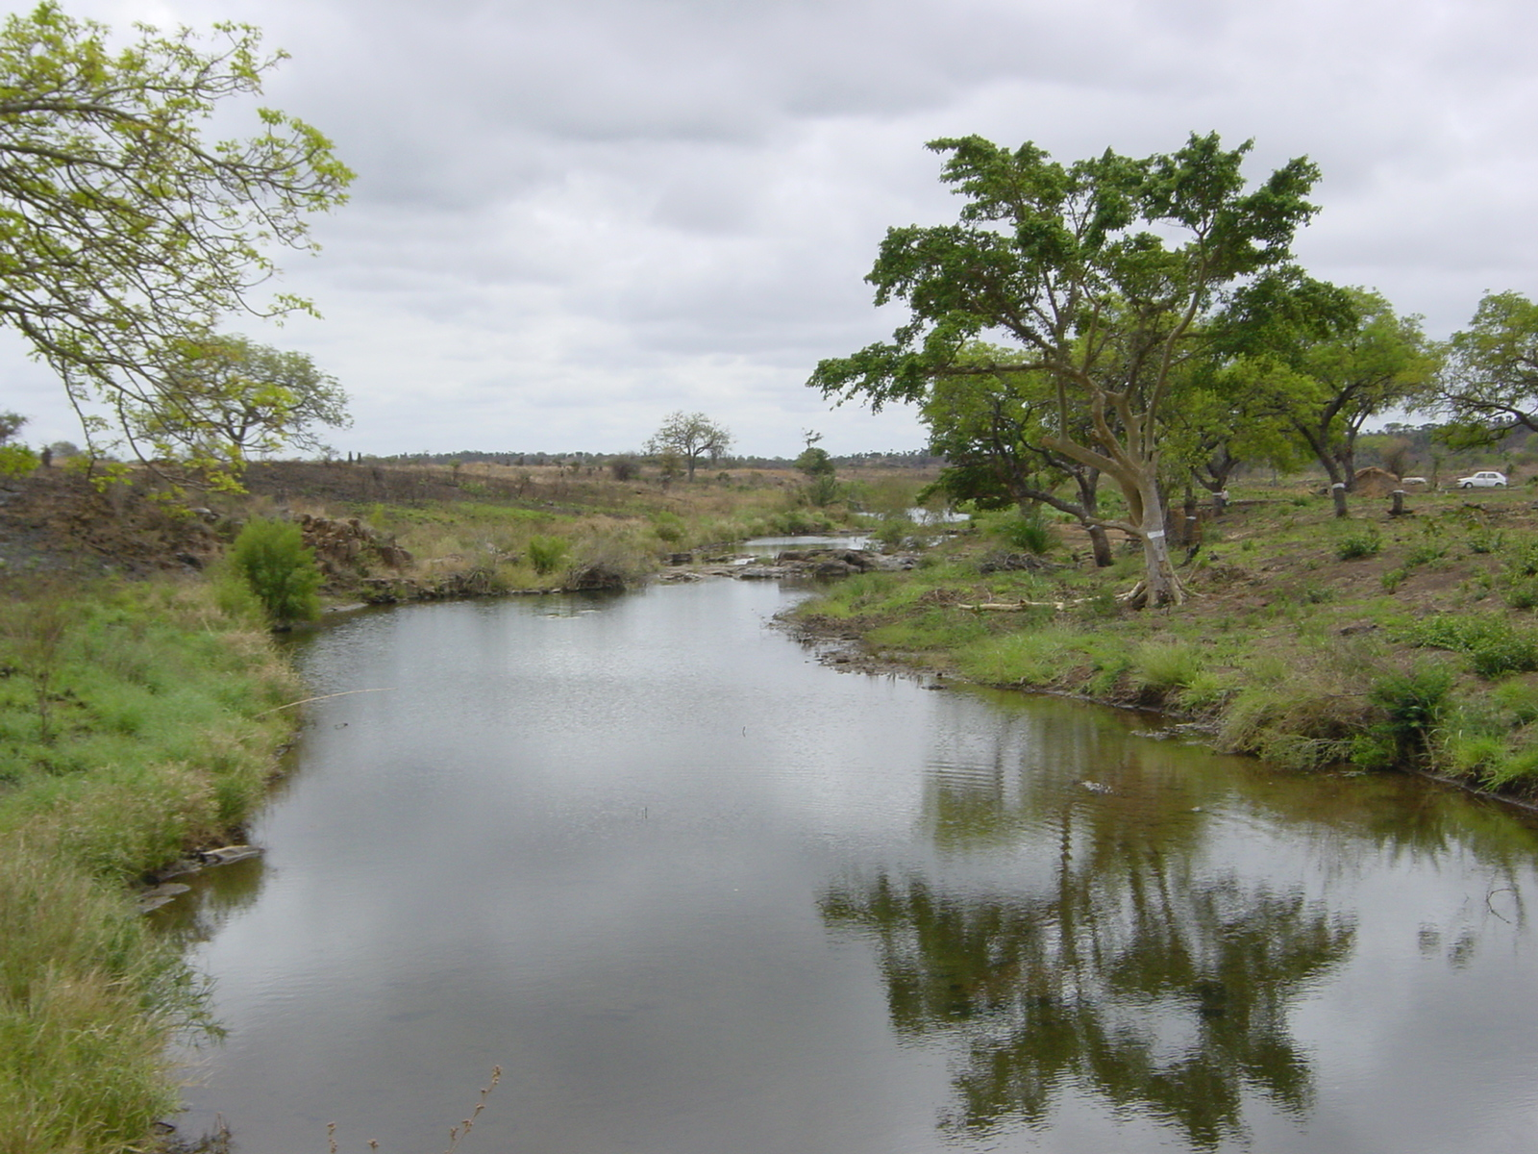
Qualitative data: examples
Landscapes
How do these two riverscapes differ?
What is qualitative about these differences?
How do we analyse these differences?
How do we re-present them in our writings?
What do these riverscapes tell us about these societies?

Slide 29

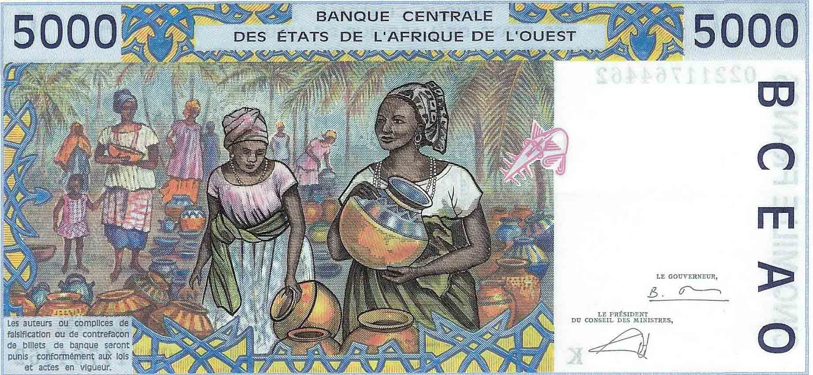
Qualitative data: examples
Banknotes
How do these banknotes differ?
What is qualitative about these differences?
How do we analyse these differences?
How do we re-present them in our writings?
What does this tell us about the culture and societies that created them?

Slide 30
Qualitative data: examples
Advertisements
How do these two advertisements differ?
What is qualitative about these differences?
How do we analyse these differences?
How do we re-present them in our writings?
What do these advertisements tell us about the culture and society in which they are found?

Slide 31
Analysing the Qualitative
An emphasis on meaning and significance
What is significant to people?
What gives objects meaning?
A focus on understanding
Getting ‘inside’
Participant observation generating our own understanding
Individuals and groups
Can we draw generalisations about groups from individual understandings?
Re-presentation
How do we ‘re-present’ our data?
What analytical frameworks can we employ?
How to enable other voices to be expressed through our work?

Slide 32
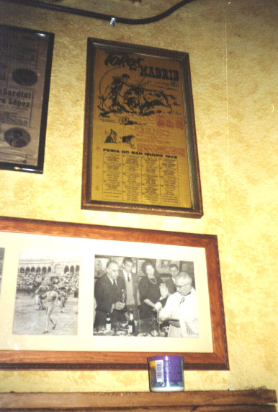
The qualitative realm
Texts, images and participation
See Limb and Dwyer (2001); Rogers and Viles (2003)
Key themes in interpreting texts
Transcription
Coding
Drawing out themes
Importance of rigour
Baxter and Eyles (1997)
Maintaining diversity
Analysing images (next lecture)
Production
The image itself
Its consumption
Participation (final lecture)
And the importance of research diaries

Slide 33
Scientific Method

Slide 34
Scientific Method Overview
The Scientific Method provides a structured approach for implementing Data Science based on data analytics
observe a problem
generate questions
create a testable explanation (hypothesis)
design an experiment to test the hypothesis
make a prediction
test the prediction using data
refine and iterate
draw a conclusion
communicate your results
Both qualitative and quantitative research methods can be utilised in the Scientific Method

Slide 35
What is Research?
A systematic means of problem solving (Tuckman 1978)
5 key characteristics:
Systematic – research process
Logical – induction/deduction
Empirical – evidence based
Reductive – generalisation
Replicable – methodology.

Slide 36
Research Process
Review the Available Literature
Publish Findings
Formulate a Question
Interpret Findings
Select an Appropriate Research Design
Collect Relevant Data

Slide 37
Research Continuum
Reductionism

Slide 38
Research Continuum
Basic
Applied
Theoretical?
More Invasive?
Laboratory Based?
Tightly Controlled?
Lacks External Validity?
Focus on Mechanism
More Reductionist
Quick Answers?
Less Invasive?
Field Based?
Loosely Controlled?
Externally Valid?
Focus on Effect
Less Reductionist.
Internal Validity?
>

Slide 39
Research Continuum
Basic
Applied
e.g.
Does Caffeine Ingestion Improve Athletic Performance?

Slide 40
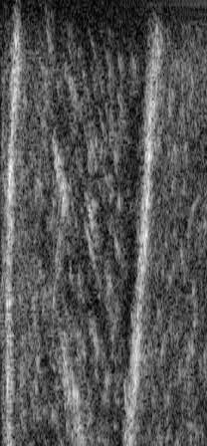
Research Continuum
Basic
Applied
e.g.
Does Caffeine Ingestion Improve Ca²⁺ binding with troponin?
-Would this Facilitate Acto-Myosin Coupling?
-Would this aid contraction?
e.g.
Does Caffeine Ingestion Improve Athletic Performance?

Slide 41
Research Continuum
Basic
Applied
e.g.
Does Caffeine Ingestion Inhibit Glycogen Phosphorylase?
Does Caffeine Ingestion Increase Lipid Metabolism?
-Would this Spare Endogenous Glycogen?
e.g.
Does Caffeine Ingestion Improve Athletic Performance?

Slide 42
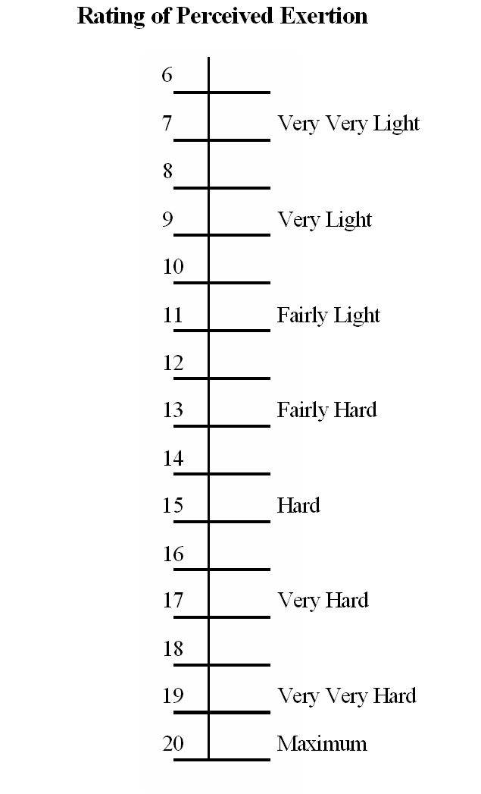
Research Continuum
Basic
Applied
e.g.
Does Caffeine Ingestion Stimulate the CNS?
-Would this Increase Motor Unit Recruitment
-Would this Reduce Perceived Effort?
e.g.
Does Caffeine Ingestion Improve Athletic Performance?

Slide 43
Research Design Continuum
Research Design
Analytical Research
Experimental Research
Descriptive Research
Pre-designs
Reviews
Quasi-designs
Philosophical
Case Study
Survey
Historical
True-designs
Cross-Sectional
Meta-Analyses
Longitudinal
Statistical-designs
Correlational

Slide 44
Analytical Research
Reviews
A critical account of present understanding
A meta-analysis is a quantitative method of review
Historical Research
Accessing both primary (e.g. witnesses) or secondary (e.g. literature) sources to document past events
Philosophical Research
Organising existing evidence into a comprehensive theoretical model

Slide 45
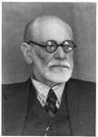
Descriptive Research
Case Study
Accrual of detailed information from an individual
Survey
Cross-sectional: Status of a various groups at a given point in time
Longitudinal: Status of a given group at various points in time
Correlational: Relationships between variables
Refutable?

Slide 46


Correlational Evidence
When variable X increases, variable Y also increases
So, does X increase Y?
or does Y increase X?
Alternatively, does Z increase both X and Y?
Correlations do not infer Causality
(and vice versa?)
See inapt use of language: Brown et al (2013)
i.e. always Read Primary Lit (inc. actual data)!

Slide 47
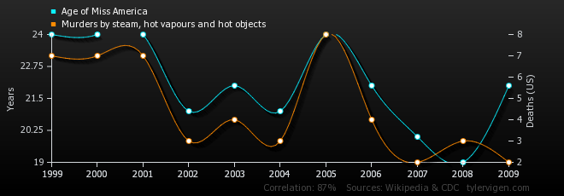
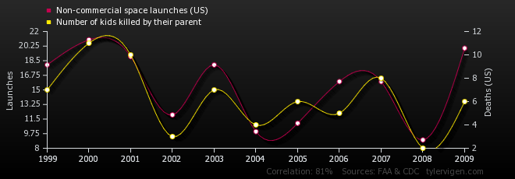
Correlation r=0.87
Correlation r=0.81
http://t.co/vWOyN0N1IB

Slide 48
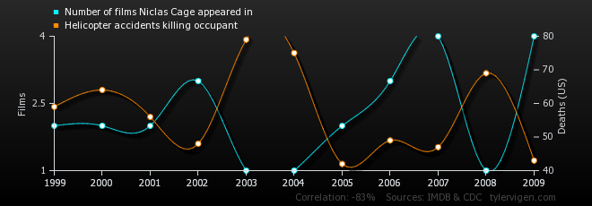
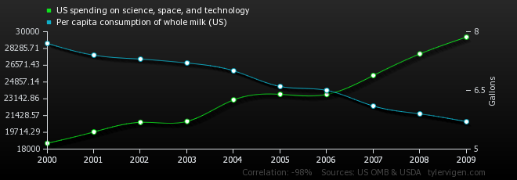
Correlation r=0.-83
Correlation r=-0.98
http://t.co/vWOyN0N1IB

Slide 49
Hypothesis

Slide 50
Hypothesis Overview
Hypothesis
A hypothesis is a proposed explanation for a phenomenon.
For a hypothesis to be a scientific hypothesis, the scientific method requires that one can test it.
In business applications, a hypothesis describes an explanation for an observed behavior.
Scientists generally base scientific hypotheses on previous observations that cannot satisfactorily be explained with the available scientific theories.
Proving or disproving a hypotheses enables the generation of insights from data analytics.
^{- Source Wikipedia}

Slide 51
Quantitative Research
Quantity is the unit of analysis
Amounts
Frequencies
Degrees
Values
Intensity
Uses statistics for greater precision and objectivity
Based on the deductive model

Slide 52
Model for Conceptualizing Quantitative Research
Overall purpose or objective
Research literature
Research questions and hypotheses
Selecting appropriate methods
Validity and reliability of the data

Slide 53
Creating the Foundation for Quantitative Research
Concept
Abstract thinking to distinguish it from other elements
Construct
Theoretical definition of a concept; must be observable or measurable; linked to other concepts
Variable
Presented in research questions and hypotheses
Operationalization
Specifically how the variable is observed or measured

Slide 54
Research Hypotheses for Quantitative Research
Educated guess or presumption based on literature
States the nature of the relationship between two or more variables
Predicts the research outcome
Research study designed to test the relationship described in the hypothesis

Slide 55
Quantitative Research Hypotheses
Directional hypothesis
Precise statement indicating the nature and direction of the relationship/difference between variables
Nondirectional hypothesis
States only that relationship/difference will occur

Slide 56
Assessing Hypotheses
Simply stated?
Single sentence?
At least two variables?
Variables clearly stated?
Is the relationship/difference precisely stated?
Testable?

Slide 57
Null Hypotheses
Implicit complementary statement to the research hypothesis
States no relationship/difference exists between variables
Statistical test performed on the null
Assumed to be true until support for the research hypothesis is demonstrated

Slide 58
Research Traditions in the Use of Hypotheses
Hypotheses are always tentative
Research hypothesis, not the null hypothesis, is the focus of the research and presented in the research report

Slide 59
Research Questions in Quantitative Research
Preferred when little is known about a communication phenomenon
Used when previous studies report conflicting results
Used to describe communication phenomena

Slide 60
Types of Variables
Variable
Element that is identified in the hypothesis or research question
Property or characteristic of people or things that varies in quality or magnitude
Must have two or more levels
Must be identified as independent or dependent

Slide 61
Independent Variables
Manipulation or variation of this variable is the cause of change in other variables
Technically, independent variable is the term reserved for experimental studies
Also called antecedent variable, experimental variable, treatment variable, causal variable, predictor variable

Slide 62
Dependent Variables
The variable of primary interest
Research question/hypothesis describes, explains, or predicts changes in it
The variable that is influenced or changed by the independent variable
In non-experimental research, also called criterion variable, outcome variable

Slide 63
Relationship Between Independent and Dependent Variables
Cannot specify independent variables without specifying dependent variables
Number of independent and dependent variables depends on the nature and complexity of the study
The number and type of variables dictates which statistical test will be used

Slide 64
Intervening and Confounding Variables
Intervening variable
Explains or provides a link between IV and DV
Relationship between the IV and DV can only be explained when the intervening variable is present
Confounding variable
Confuses or obscures the effect of independent on dependent
Makes it difficult to isolate the effects of the independent variable

Slide 65
Operationalizing Variables
All variables need an operationalization
Multiple operationalizations exist for most variables
Specifies the way in which variable is observed or measured
Practical and useful?
Justified argument?
Coincides with the conceptual definition?

Slide 66
Making the Case for Quantitative Research
Advantages
Tradition and history implies rigor
Numbers and statistics allows precise and exact comparisons
Generalization of findings
Limitations
Cannot capture complexity of communication over time
Difficult to apply outside of controlled environments

Slide 67
Issues of Reliability and Validity
Reliability = consistency in procedures and in reactions of participants
Validity = truth - Does it measure what it intended to measure?
When reliability and validity are achieved, data are free from systematic errors

Slide 68
Threats to Reliability and Validity
If measuring device cannot make fine distinctions
If measuring device cannot capture people/things that differ
When attempting to measure something irrelevant or unknown to respondent
Can measuring device really capture the phenomenon?

Slide 69
Other Sources of Variation
Variation must represent true differences
Other sources of variation
Factors not measured
Personal factors
Differences in situational factors
Differences in research administration
Number of items measured
Unclear measuring device
Mechanical or procedural issues
Statistical processing of data

Slide 70
Experiments

Slide 71
Experiments Overview
In the scientific method an experiment is an empirical procedure that arbitrates competing models or hypotheses.
Researchers use experimentation to test existing theories or new hypotheses to support or disprove them.
An experiment usually tests a hypothesis, which is an expectation about how a particular process or phenomenon works.
An experiment may also aim to answer a "what-if" question, without a specific expectation about what the experiment reveals, or to confirm prior results.
If an experiment is carefully conducted, the results usually either support or disprove the hypothesis.
- Source Wikipedia

Slide 72

Scientific Reasoning (Logic)
Quantitative?
Confirmation of a theory from your own observations
General Theory
Deductive Reasoning
Specific Observation
Inductive Reasoning
Formation of a theory grounded in your own observations
Qualitative?

Slide 73
Choice of Research Strategy…
Based on:
Epistemology (How should we be attempting to assess knowledge?)
Positivism = explain a phenomena
Interpretivism = understand a phenomena
Ontology (Does the data exist in a tangible or an intangible form?)
Objectivism = explain independent external outcomes
Constructionism = understand how social factors interact

Slide 74
Choice of Research Strategy…
Study in the natural sciences often requires a positivistic epistemology and an objectivistic ontology
Study in the social sciences often requires an interpretive epistemology and a constructionist ontology
However, it is occasionally possible to combine these strategies by coding qualitative data quantitatively (i.e. Athlete = 1 ; Non-Athlete = 2)

Slide 75
Sampling

Slide 76
Sampling Concepts
In statistics, quality assurance, and survey methodology, sampling is concerned with the selection of a subset of individuals from within a statistical population to estimate characteristics of the whole population.
Two advantages of sampling are that the cost is lower and data collection is faster than measuring the entire population.
Each observation measures one or more properties (such as weight, location, color) of observable bodies distinguished as independent objects or individuals.
Results from probability theory and statistical theory are employed to guide the practice.
In business research, sampling is widely used for gathering information about a population.
The sampling process comprises several stages:
Defining the population of concern
Specifying a sampling frame, a set of items or events possible to measure
Specifying a sampling method for selecting items or events from the frame
Determining the sample size
Implementing the sampling plan
Sampling and data collecting
- Source Wikipedia

Slide 77

Sampling
-Split into research teams
-Each person take a ‘sample’ of Smarties
-Each group record the total number of
Smarties and the number of red Smarties

Slide 78

Sampling
Target Pop.
(N)
Sample (n)
Effective Sampling produces a n which is representative of N
Note: n is only ever representative of the N it was drawn from, i.e. not necessarily the general population.

Slide 79
Sampling
Statistics
The dependent variable can be generalised from n to N

Slide 80

Sampling Methods
Random- All members of N have an equal chance of selection
Stage- Randomly select a group, then take sample
Cluster- Select a natural group to sample from
e.g.
School
Class
e.g.
e.g. local community

Slide 81
Sampling Methods
Stratified- identify strata and sample accordingly
Systematic- e.g. every fourth person but starting at a random point
Opportunity- sample a convenient group
i.e. Global Pop. Sample (n=100)
= 51% = 51
= 49% = 49
Avoid Researchers!

Slide 82
Lesson Review

Slide 83
Lesson Review
Consider the following questions that you should be able to answer by completing Day 5.
What is the main purpose of research?
What types of research activities exist?
How does the scientific method compare to CRISP-DM?
What are some techniques for generating effective business questions?
What is a practical definition of a hypothesis?
What role does Operational Excellence play in generating effective business questions?

Slide 84
Lesson Summary

Slide 85
Day 5 Lesson Summary
During Day 5 you learned to:
Identify and describe the approach and objectives of research
Describe two different types of research methods
Describe how research methods enable successful business impact of data analytics
Discover the business questions you are trying to answer with data analytics.
Determine if your data is appropriate to support your analytics initiative
Describe some data collection techniques and some related sampling concerns
Recognize how Operational Excellence initiatives drive analytics requirements
Check your data for some common issues in Python and interpret results from a regression model
Have a general understanding of what kinds of models for analysis are readily available in Sci-kit Learn Python

